Slide 2
Layout with CSS

Slide 3
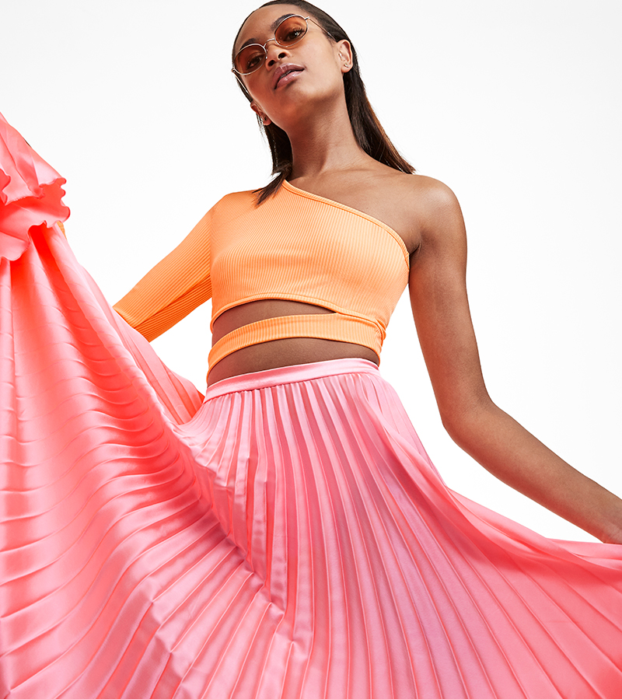
CSS Box model
The CSS box model is the foundation of layout on the Web — each element is a rectangular box.

Slide 4
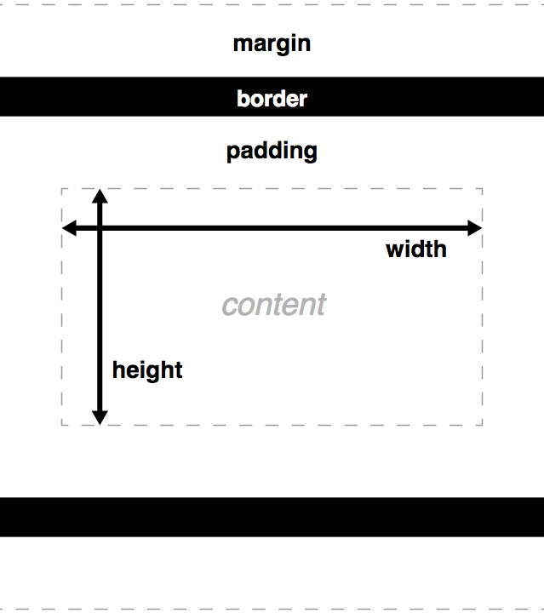
Notes:
The core of the box is defined by the width and height of an element, which may be determined by the display property, by the contents of the element, or by specified width and height properties. Padding and then border expand the dimensions of the box outward from the element’s width and height. Lastly, any margin we have specified will follow the border.

Slide 5
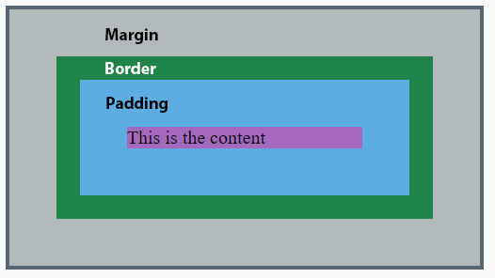

Slide 6
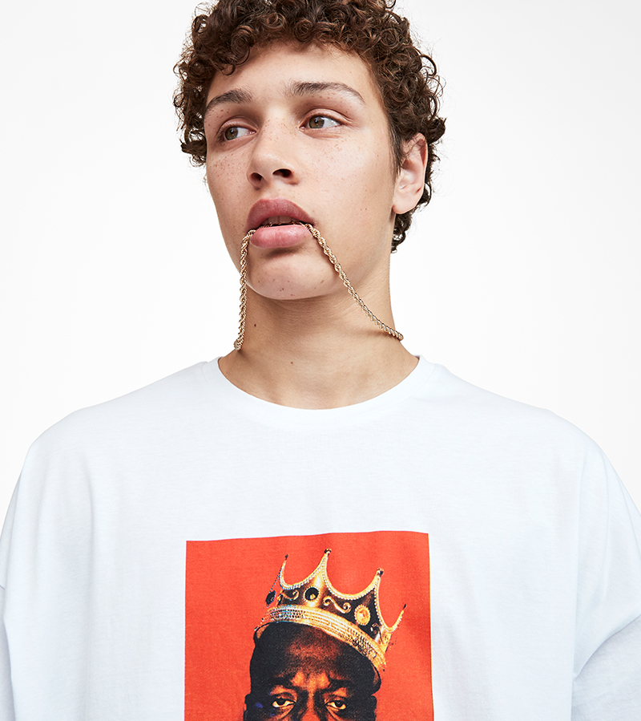
Example
div {
border: 6px solid #949599;
height: 100px;
margin: 20px;
padding: 20px;
width: 400px;
}
The total width of this element is:
margin-right
+ border-right
+ padding-right
+ width
+ padding-left
+ border-left
+ margin-left
Total Width: 492px = 20px + 6px + 20px
+ 400px + 20px + 6px + 20px
Notes:
The width property is the width of the content

Slide 7
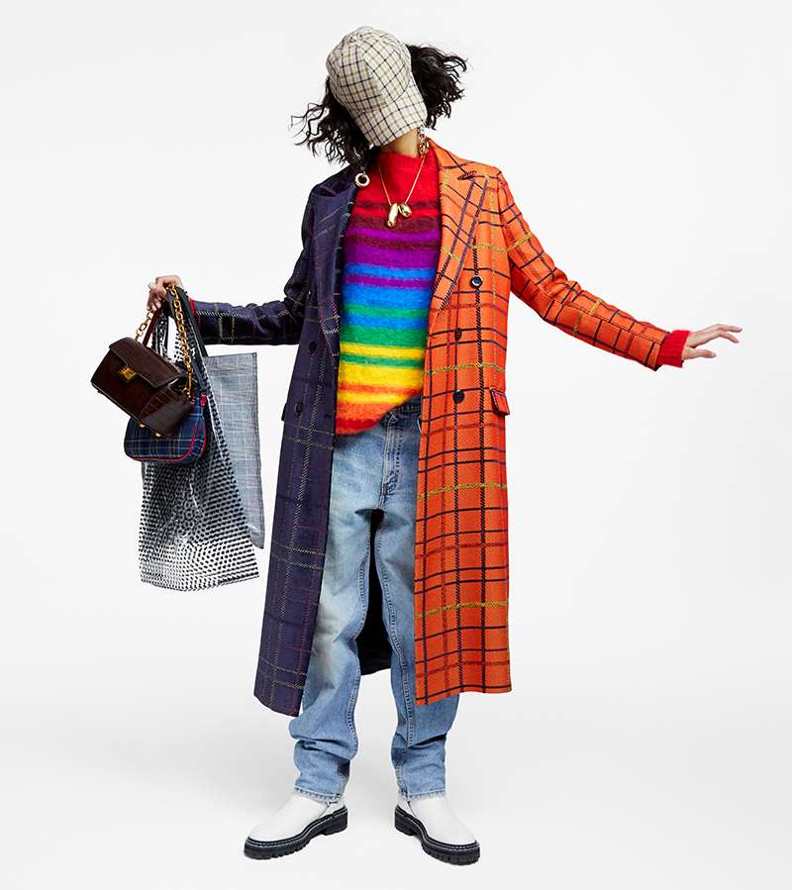
Box display types
Common types
Block
Stacks on other boxes
Can have height and width
Inline
Flows with text
No height and width
Inline-block
Flows with text
Can be sized

Slide 8
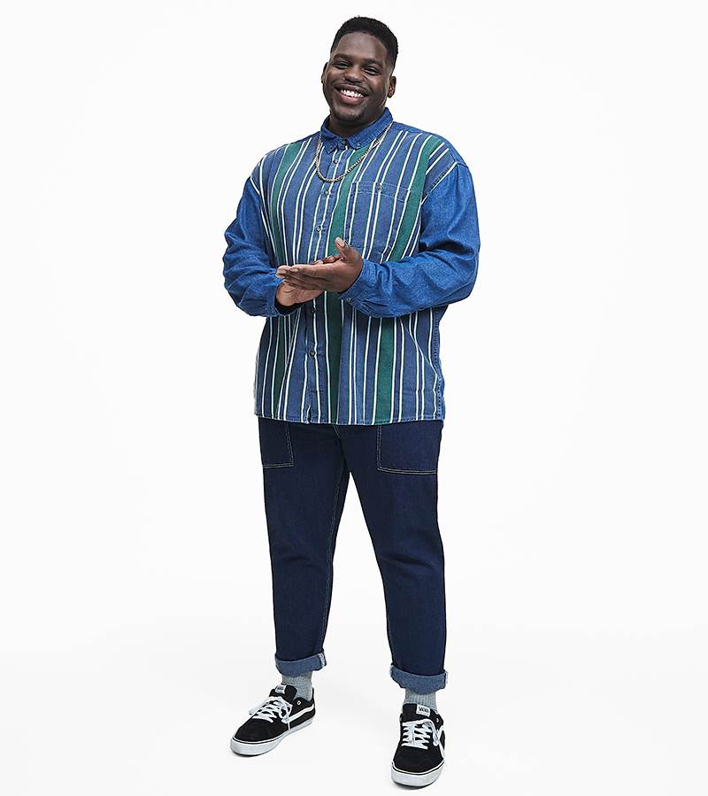
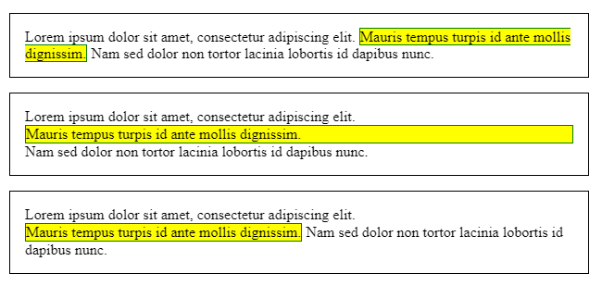
Quiz!
Which is which?

Slide 9

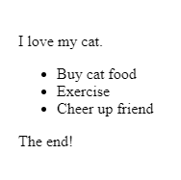
<p>I love my cat.</p> <ul> <li>Buy cat food</li> <li>Exercise</li> <li>Cheer up friend</li> </ul> <p>The end!</p>
Normal flow
<p>I love my cat.</p>
<ul>
<li>Buy cat food</li>
<li>Exercise</li>
<li>Cheer up friend</li>
</ul>
<p>The end!</p>
HTML is displayed in the exact order in which it appears in the source code, with elements stacked up on top of one another

Slide 10
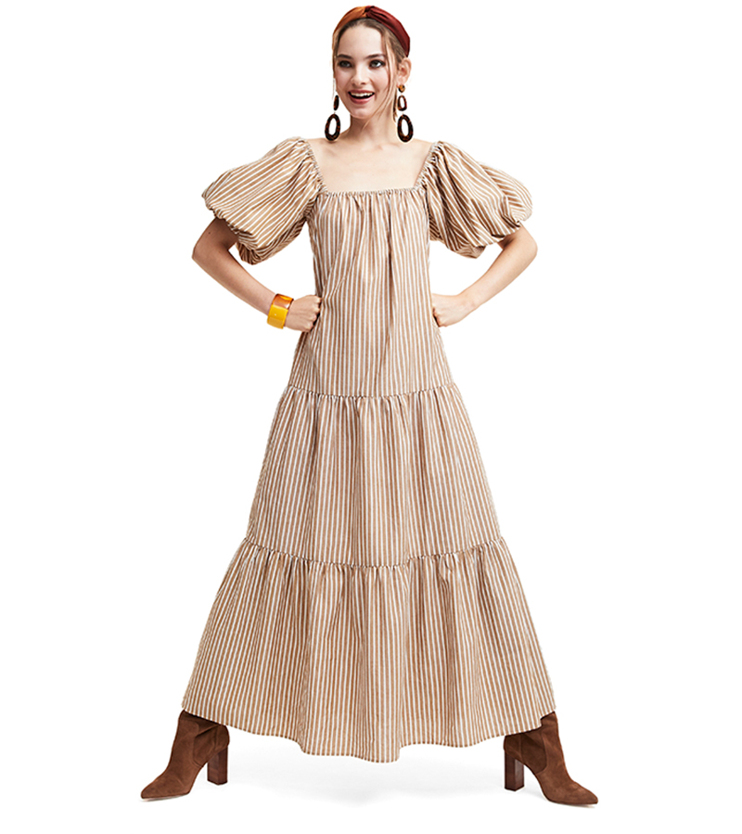
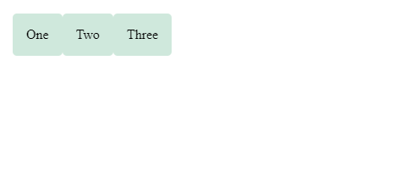
Flexbox
.wrapper { display: flex; }
<div class="wrapper">
<div class="box1">One</div>
<div class="box2">Two</div>
<div class="box3">Three</div>
</div>
Notes:
Flexbox is the short name for the Flexible Box Layout Module, designed to make it easy for us to lay things out in one dimension — either as a row or as a column. To use flexbox, you apply display: flex to the parent element of the elements you want to lay out; all its direct children then become flex items.

Slide 11
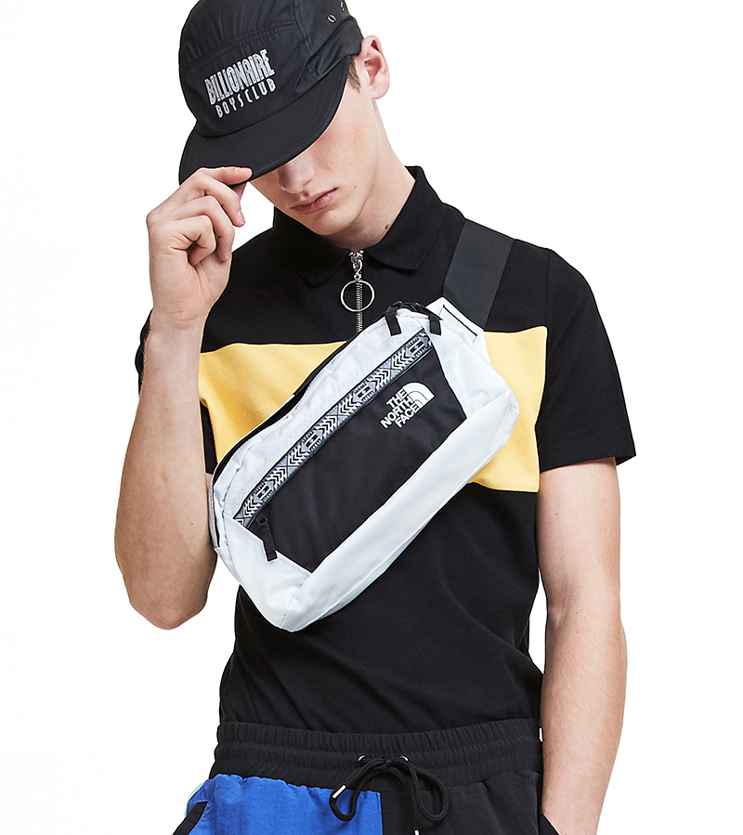
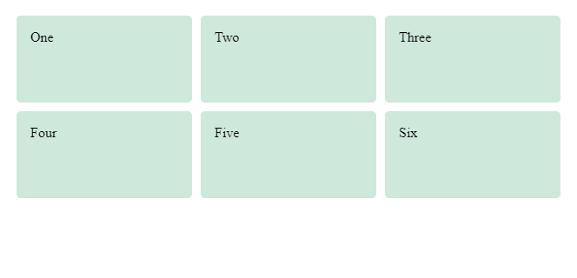
Grid Layout
.wrapper {
display: grid;
grid-template-columns: 1fr 1fr 1fr;
grid-template-rows: 100px 100px;
grid-gap: 10px; }
<div class="wrapper">
<div class="box1">One</div>
<div class="box2">Two</div>
<div class="box3">Three</div>
<div class="box4">Four</div>
<div class="box5">Five</div>
<div class="box6">Six</div>
</div>

Slide 12
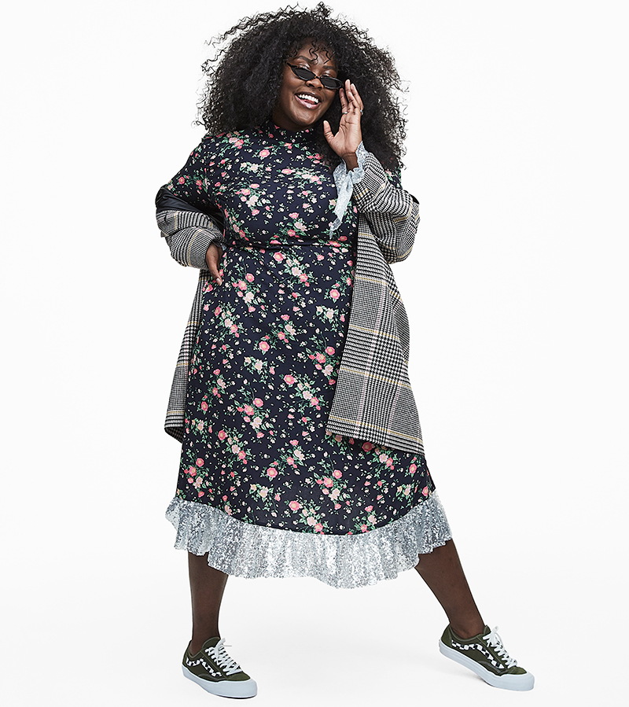
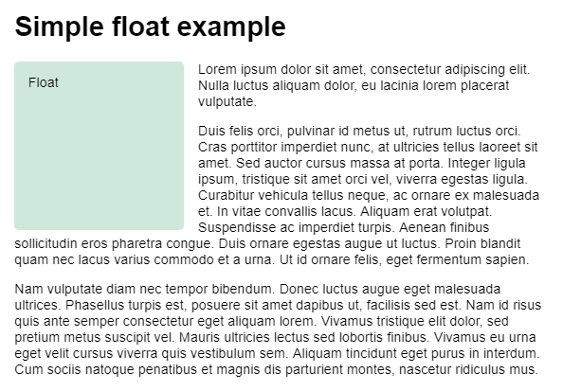
Floats
Originally for adding an image with the text wrapping around it
Has been used to create website layouts
But can use new layouts instead

Slide 13
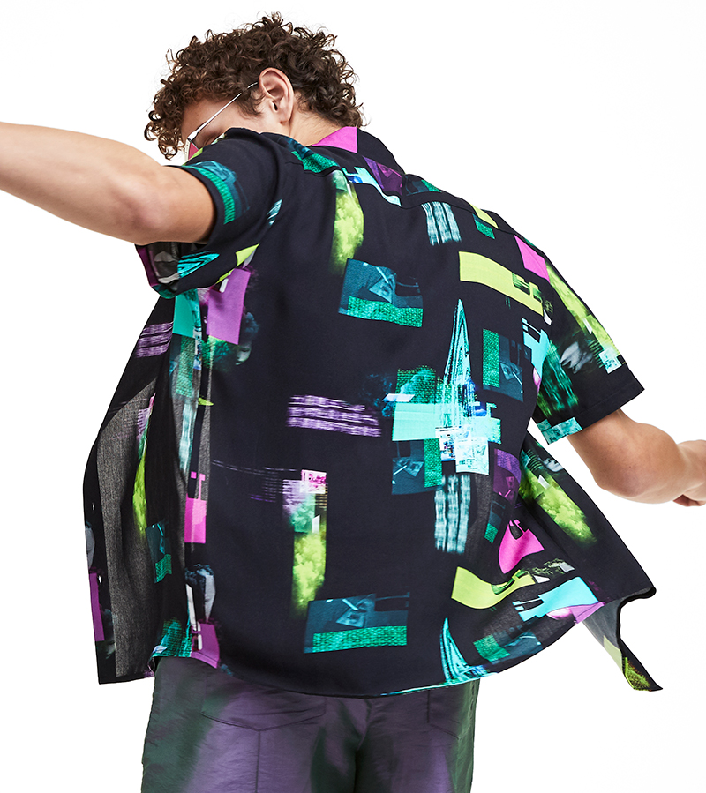
Positioning
Override the basic document flow behaviour
Static – default behavior
Relative – move with top, bottom, left, right
Absolute – specify position
Sticky – relative until scrolled to fixed sticking point (hybrid)

Slide 14



Integration
Add videos and posts from other sites

